Slide 1

DATABOOTCAMP PROJECT GROUP-8
PRESENTATION BY –
Aitor Goyenechea
Alexander Rahmanov
Noran Abou-Zaid
Tally Anter-Rupa
Versha Rangaswamy

Slide 2

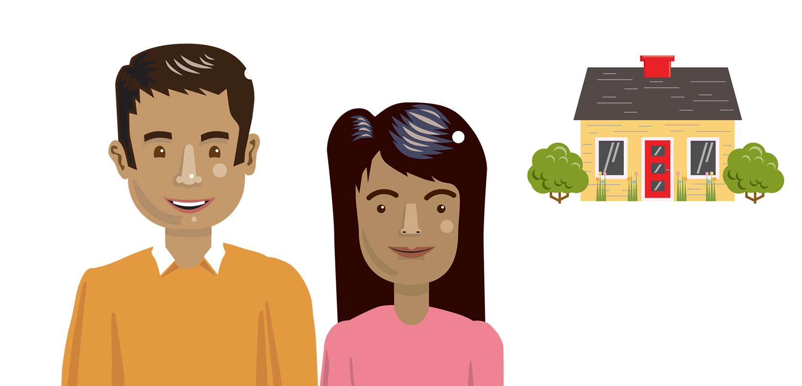

Our goal
To provide clarity to potential buyers where, given their budget and desired square footage, they can afford to purchase a property in New York City, and predict current property price based on 15 years of historical sales data.
Notes:
Aitor
Given the rapidly increasing prices of the housing market, how does a prospective home buyer decide where to purchase a home in New York City?

Slide 3



Why is this important?
Provide transparency in pricing to prospective buyers
Allow buyers to make an informed purchase decision
Remove some of the stress from making a major purchase decision
Notes:
Aitor

Slide 4
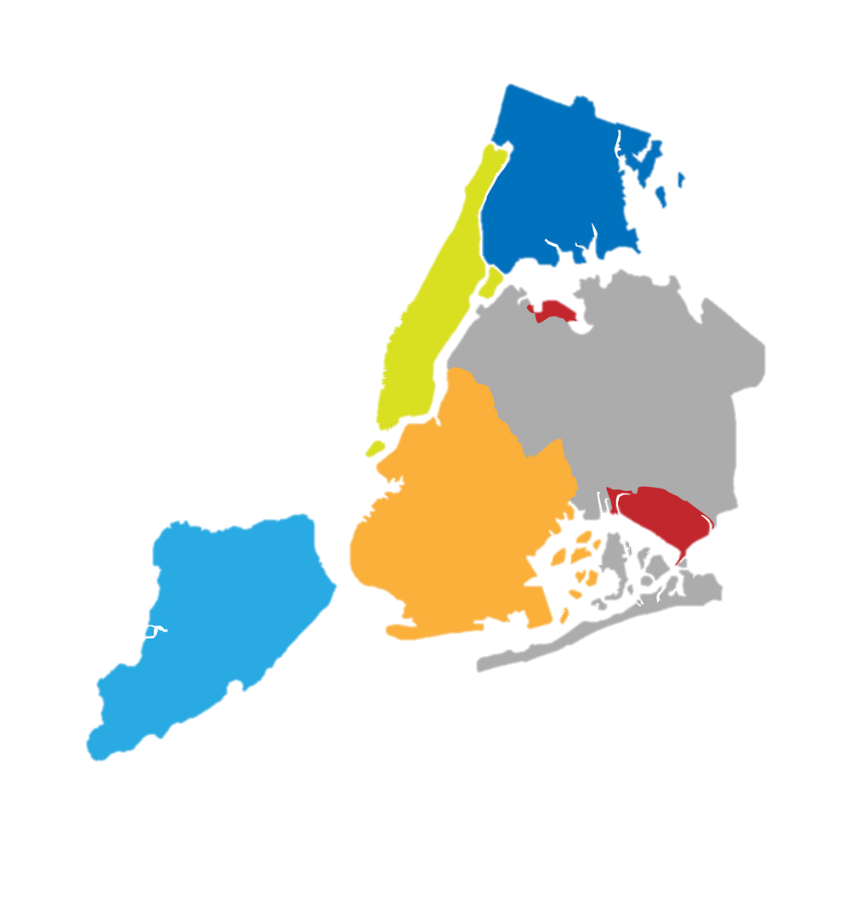
Database available
Data we retained
Borough
Neighborhood
Building Class Category
Tax Class
Block
Lot
Easement
Building Class at Present
Address
NYC Property Sales
for 15 years from 2003-2018
for the 5 NYC boroughs
Zip Code
Residential Units
Commercial Units
Year Built
Building Class at Time of Sale
Gross Square Feet
Sale Price
Sale Date
Bronx
Manhattan
Queens
Brooklyn
Staten
Island
Notes:
Aitor
2019 data was incomplete, so we decided to ignore it

Slide 5








Technologies we used
Data Cleaning & Exploratory
Analysis
Database Storage
Machine Learning
Dashboard Visualization
Notes:
Noran

Slide 6

Data Exploration
Database Storage & Integration
Uploaded to AWS (RDS & S3)
Tables created in PgAdmin
Connected using SQLAlchemy
Notes:
Noran
Database was uploaded to AWS using RDS & S3
Tables were created in PgAdmin for each borough
AWS was connected to PgAdmin using SQLAlchemy

Slide 7

Data Exploration
Database Cleaning
Cleaned using Python in CoLab
$/sqf, Year, Month columns were added
Filtered based on building class category
Dropped rows where sq feet or price = 0
Quantiles were calculated by Borough and Year
Notes:
Noran
Database was cleaned using python in CoLab
Retained columns from DB were Borough, Neighborhood, Building Class Category, Address, Zip Code, Gross Square Feet, Sale_Price, Sale_Date
$sqf, Year, Month columns were added
Filtered Building Class Categories and Commercial rows based on category
Dropped rows where sq feet or price were 0
$sqf column was created to compare prices per property; quantiles were calculated by Borough and Year; top and bottom 5% were dropped for each group

Slide 8
Data Exploration
Database Storage & Integration
2 tables created for Sales & Address using PgAdmin
Numeric index column created as primary key
Table joined in PgAdmin- Sales_Join_
Address
Notes:
Noran
Database was uploaded to AWS using RDS & S3
Tables were created in PgAdmin for each borough
AWS was connected to PgAdmin using SQLAlchemy

Slide 9
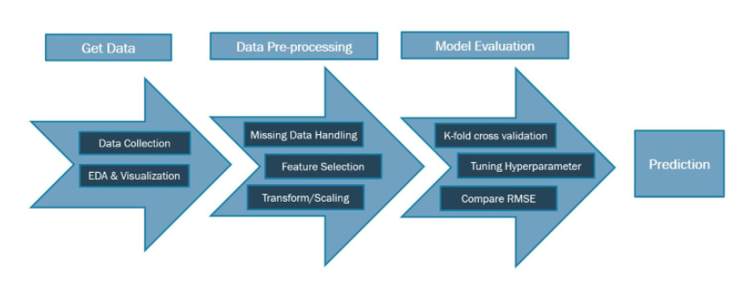
Analysis
Choosing a Machine Learning Model:
Linear regression was likely the best model
Validated model choice by testing:
Linear regression
Robust regression
Ridge regression
Lasso regression
Elastic net regression
Polynomial regression
Neural network
Notes:
Tally
As desired output is continuous data (current sale price) - linear regression was likely the best model
Sales data from 2003-2015 was used to train the model and 2016-2018 data was used to test.

Slide 10
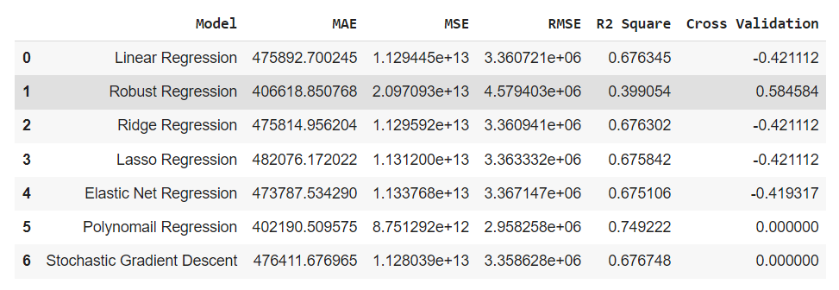
Results of the Analysis
From all the models we tested, Polynomial regression yielded the highest degree of accuracy.
Notes:
Tally
Neural network was considered and tested, however the R2 value was less than 0.25, so it is not included in the summary.

Slide 11

Our MVP - NYCCasa
Notes:
Our Minimum Viable Product which we have proudly built in the last 5 weeks is called NYCCasa. Without any ado let’s give you a video demo to avoid any lag. NYCCasa will help potential buyers browse through scores of property data of the 5 New York City boroughs to help gather information to make an informed decision to find their next home. The dashboard has been made interactive to include historical sales price data by borough for 13 years and shows the trend in sales price. It also provides an interactive map with locations of all addresses and their corresponding data such as neighborhood, square feet and average sales price through the years. It also provides a sample database which the home buyers could download as a csv in the future. As part of product development, we will enable Filter Capabilities for the database in the future on top of our current beta version.

Slide 12
Next Steps…
Find a data set or web scrape data that included additional details such as number of bedrooms, number of bathrooms, parking lot, apartment view, last sale date etc.
Use the housing inflation index data and test if it improved the accuracy of our machine learning model.
We want the model to predict the prices 1-2 years out in the future.
Web Scrape data from ZooCasa to perform similar analysis and building model for Toronto
Expand capabilities of website to segregate database into 5 boroughs instead of a sample
Notes:
So, What are the next steps?
We want to provide additional information such as # of bedrooms, # of bathrooms, parking lot, apartment view, last sale date etc to the homebuyers, which I am sure they will appreciate. We will gather this through a new database or web scraping.
To make our predicted current price more robust we will use housing inflation index dataset to test accuracy of our ML model. Additionally, we will further build our model to predict property prices 1-2 years into the future.
We want to eventually expand our market base into Toronto as well and will use web scraping to get more robust database for Toronto housing market from ZooCasa.
We want to increase our website capabilities to segregate display table into the 5 boroughs instead of a single sample table to improve searchability for the user.
We thank you for your time and are open to any questions

Slide 13
Thank you!

